Slide 1
Haskell in der Industrie
Vom Schachprogramm in 200 Zeilen zum Gamechanger
“As long as our hypothetical Blub programmer is looking down the power continuum, he knows he's looking down. Languages less powerful than Blub are obviously less powerful, because they're missing some feature he's used to. But when our hypothetical Blub programmer looks in the other direction, up the power continuum, he doesn't realize he's looking up. What he sees are merely weird languages. He probably considers them about equivalent in power to Blub, but with all this other hairy stuff thrown in as well. Blub is good enough for him, because he thinks in Blub.”
From the essay “Beating the Averages” by Paul Graham
(Startup Millionaire, co-Founder of YCombinator)

Slide 2
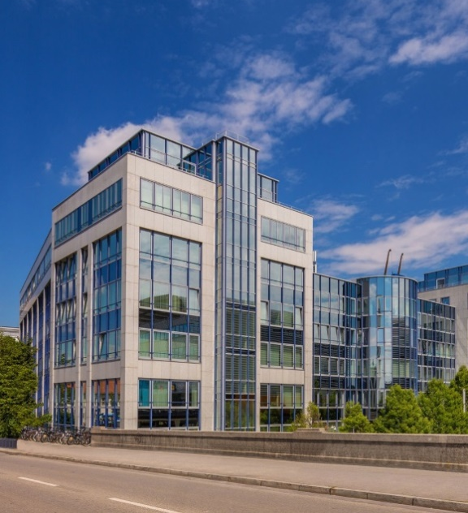
Vorstellung
TCS@LMU Alumni
Dependent Types for Haskell (Microsoft Research, UK)

Slide 3
Inhalt
Schach in 200 Zeilen. Warum?
Und ein bißchen Code und ein Demo
Kontext@Validas: Functional Safety
Die Challenge
R2
Industrielle Einsatzgebiete von Haskell
Meta-Probleme
Fragen/Diskussion

Slide 4
Schach in 200 Zeilen. Warum?
Weil es geht ☺
Später: Showcase für Haskell im Unternehmen:
Übersichtlicher, einfach verständlicher Code (kleine Semantic Gap)
Korrektheit: „Das ist so einfach, das muss stimmen!“

Slide 5
data Colour = White | Black
deriving (Show,Eq,Enum,Bounded,Ord)
nextColour White = Black
nextColour Black = White
data Piece = Ù | Ú | Û | Ü | Ý | Þ
deriving (Eq,Enum,Bounded,Ord,Show)
type Board = Array Coors Square
type Square = Maybe (Colour,Piece)
type Coors = (Int,Int)
instance Show Coors where
show (file,rank) = ['a'..]!!(file-1) : show rank
data Position = Position {
pBoard :: Board,
pColourToMove :: Colour,
pCanCastleQueenSide :: [Colour],
pCanCastleKingSide :: [Colour],
pEnPassant :: Maybe (Coors,Coors),
pHalfmoveClock :: Int,
pNextMoveNumber :: Int }
initialPosition = Position {
pBoard = boardFromString [
"âïáòäðàñ",
"îßîßîßîß",
"ØçØçØçØç",
"çØçØçØçØ",
"ØçØçØçØç",
"çØçØçØçØ",
"ÙèÙèÙèÙè",
"ëÚêÝíÛéÜ" ],
pColourToMove = White,
pCanCastleQueenSide = allOfThem,
pCanCastleKingSide = allOfThem,
pEnPassant = Nothing,
pHalfmoveClock = 0,
pNextMoveNumber = 1 }

Slide 6
potentialMoves Position{..} = normal_moves ++ castling_moves where
normal_moves = [ Move src dest mb_takes mb_promote |
(src,Just (colour,piece)) <- assocs pBoard,
colour==pColourToMove,
(dest@(_,to_rank),mb_takes) <- [..] case piece of
Ù → pawn_moves ++ pawn_takes
where
Just dest = addCoors pBoard src pawn_step
-- There cannot be a pawn on the opposite base rank
pawn_moves = if square_empty dest then [ (dest,Nothing) ] ++ pawn_double else []
pawn_double = case addCoors pBoard src (2*pawn_step) of
Just dest2 | square_empty dest2 ∧ snd src == initial_rank → [(dest2,Nothing) ]
_ | otherwise → []
pawn_takes = [ (dest,Just take_on) |
Just dest <- map (addCoors pBoard src) [pawn_step+east,pawn_step+west],
take_on <- case pBoard!dest of
Just (colour,_) | colour ≠ pColourToMove → [ dest ]
Nothing | Just (middle,pawn_coors) <- pEnPassant, middle==dest → [ pawn_coors ]
_ | otherwise → [] ]
Ú → concatMap (maybe_move src) knight_moves
Û → concatMap (maybe_move_direction src) diagonals
Ü → concatMap (maybe_move_direction src) straights
Ý → concatMap (maybe_move_direction src) (straights++diagonals)
Þ → concatMap (maybe_move src) (straights++diagonals),

Slide 7
Searching Brute Force Minimax
type Depth = Int
type Line = [Move]
search :: Depth → Position → Line → (Rating,Line)
search depth pos line | moveGen pos == [] ∨ depth==0 = (fst $ rate pos,line)
search depth pos line = minimax (comparing fst) (map go_deeper $ moveGen pos)
where
minimax = if pColourToMove == White then maximumBy else minimumBy
go_deeper move = search (depth-1) (doMove pos move) (move:line)
No side effects!
import Control.Parallel.Strategies
parMap rpar

Slide 8
Eine kleine Partie mit Chess200

Slide 9


Kontext @ Validas
Funktionale Sicherheit von Software

Slide 10

Funktionale Sicherheit

Slide 11

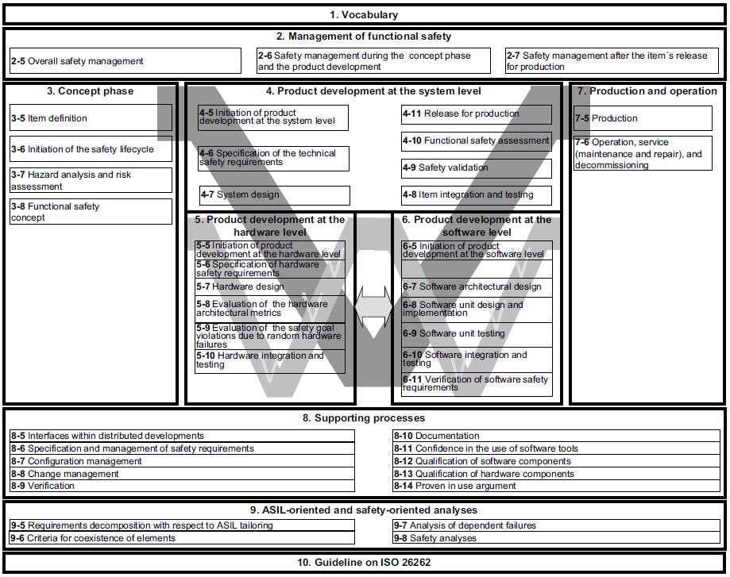
Functional Safety Standards

Slide 12
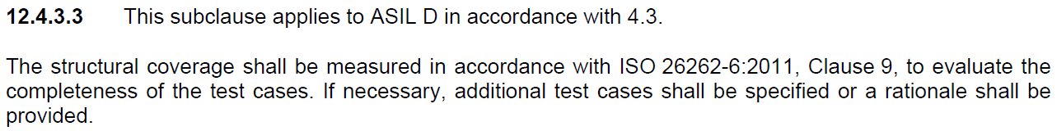
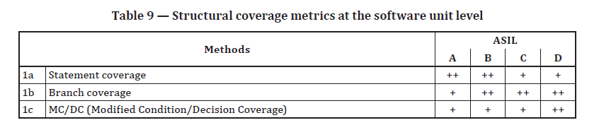
Libraries in ISO26262

Slide 13
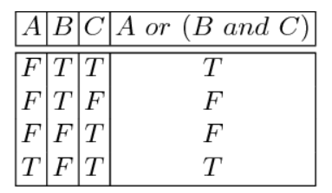
MC/DC Coverage
if ( A || ( B && C ) )
Jede Condition T und F (alle anderen Conditions gleich) => Decision ändert sich

Slide 14
Coverage-Beispiel
Auftrag von großem Hersteller:
„Qualifiziere Funktionen der libgcc Standard Library!“
_fpdiv_parts ( fp_number_type * a, fp_number_type * b )

Slide 15
static inline __attribute__ ((__always_inline__))
fp_number_type *
_fpdiv_parts (fp_number_type * a, fp_number_type * b)
{
fractype bit,numerator,denominator,quotient;
if (isnan (a)) return a;
if (isnan (b)) return b;
a->sign = a->sign ^ b->sign;
if (isinf (a) || iszero (a))
{
if (a->class == b->class) return nan ();
return a;
}
if (isinf (b))
{
a->fraction.ll = 0;
a->normal_exp = 0;
return a;
}
if (iszero (b))
{
a->class = CLASS_INFINITY;
return a;
}
a->normal_exp = a->normal_exp - b->normal_exp;
numerator = a->fraction.ll;
denominator = b->fraction.ll;
if (numerator < denominator)
{
numerator *= 2;
a->normal_exp--;
}
bit = IMPLICIT_1;
quotient = 0;
while (bit)
{
if( solver_pragma(1,12,12,2,1,2,1,2,1,2,1,2,1,2,1,2,1,2,1,2,1,2,1,2,1,2,2,12,12,12,12) &&
numerator >= denominator)
{
quotient |= bit;
numerator -= denominator;
}
bit >>= 1;
numerator *= 2;
}
if (!ROUND_TOWARDS_ZERO && (quotient & GARDMASK) == GARDMSB)
{
if (quotient & (1 << NGARDS)) { }
else if (numerator)
{
quotient += GARDROUND + 1;
/* Avoid further rounding in pack_d. */
quotient &= ~(fractype) GARDMASK;
}
}
a->fraction.ll = quotient;
return (a);
}
Welche Argumente für a und b
um diesen Code zu covern?

Slide 16
Lösung von R2
---- Trace [2,2,3,2,2,2,1,1,1,2,1,2,1,2,1,1,1,2,1,1,1,2,1,1,1,2,1,1,1,2,1,1,1,2,1,1,1,2,1,1,1,2,1,1,1,2,1,1,1,2,1,1,1,2,1,1,1,2,1,2,1,2,1,2,1,2,1,2,2,2,2,1]
_fpdiv_parts ( a = <SOME_PTR> , a_ARROW_class = 144 , a_ARROW_sign = 0 , a_ARROW_normal_exp = 0 , a_ARROW_fraction_DOT_ll = 3361863152 ,
b = <SOME_PTR> , b_ARROW_class = 1610612736 , b_ARROW_sign = 0 , b_ARROW_normal_exp = 0 , b_ARROW_fraction_DOT_ll = 3103258313 )
= return_val = <SOME_PTR> , return_val_ARROW_class = 144 , return_val_ARROW_sign = 0 , return_val_ARROW_normal_exp = 0 , return_val_ARROW_fraction_DOT_ll = 1163220352
DECISION POINTS (IN CONTROL FLOW ORDER):
Else branch 2 "if(isnan(a))" at line 927, col 7, len 9
Else branch 2 "if(isnan(b))" at line 931, col 7, len 9
Else branch 3 "(F||F) in if(isinf(a) || iszero(a))" at line 938, col 7, len 23
Else branch 2 "if(isinf(b))" at line 945, col 7, len 9
Else branch 2 "if(iszero(b))" at line 951, col 7, len 10
Else branch 2 "if(numerator < denominator)" at line 968, col 9, len 23
Then branch 1 "for/while(bit)" at line 977, col 12, len 3
Then branch 1 "if(numerator >= denominator)" at line 980, col 17, len 112
[..]
Else branch 2 "for/while(bit)" at line 977, col 12, len 3
Then branch 2 "(T&&T) in if(!0 && (quotient & 0x7f) == 0x40)" at line 989, col 9, len 31
Else branch 2 "if(quotient & 1 << 7L)" at line 991, col 6, len 20
Then branch 1 "if(numerator)" at line 998, col 11, len 9
checkSolutionM [2,2,3,2,2,2,1,1,1,2,1,2,1,2,1,1,1,2,1,1,1,2,1,1,1,2,1,1,1,2,1,1,1,2,1,1,1,2,1,1,1,2,1,1,1,2,1,1,1,2,1,1,1,2,1,1,1,2,1,2,1,2,1,2,1,2,1,2,2,2,2,1] ok.
--------------------------
DEAD Else branch 1 "(F&&_) in if(!0 && (quotient & 0x7f) == 0x40)" at line 989, col 9, len 31

Slide 17
R2
3500 LoC
C Source Code -> Z3 SMT Solver Formel
Überprüfung der theoretischen Voraussagen: Compilieren, ausführen und Ergebnisse vergleichen (Absicherung!)
Schleifenlängen-Inferenz
Induktive MC/DC-Tabellengenerierung (neu?!)
Diverse Optimierungen gegen State Space Explosion
Viele Inspirationen aus Schachprogrammierung ☺

Slide 18
Gamechanger
Evaluierung: Andere Tools? Ja, aber nur stark eingeschränkt...
Bestes Konkurrenz-Tool: VectorCAST (kommerzielles Testingtool) => Anfrage bei Vector: Konnte schon erstes Beispiel nicht…
Bewährung in kommerziellem Projekt
Macht saubere Library-Qualifizierung möglich!

Slide 19
Warum hilft Haskell hier?
Behauptung: R2 in keiner anderen Sprache entwickelbar
Starkes Typsystem
Mathematisch abstrakte Ausdrucksform (High-Level, d.h. kleine „Semantic Gap“)
Fehlervermeidung (Null Fehlertoleranz!)
Implementierung bleibt handhabbar
Vorteil gegenüber Konkurrenz!

Slide 20

Anwendungsbeispiel: Code-Patterns
Gefährlich: Increment-/Decrement-Operatoren in „komplexen“ Ausdrücken!
y = z++ > 10000 ? g(z) : g(z+2); y == ?
→ Verboten durch Coding Guidelines!
Überprüfung durch DSL:
complexExpr = ternaryIf <+> binaryOp
incOrDecOp cunary@(CUnary unop _ _) | unop `elem` [CPostIncOp,CPostDecOp,CPreIncOp,CPreDecOp] = [cunary]
incOrDecOp _ = []
incDecOpComplexExpr = findAll complexExpr >>> findAll incOrDecOp >>> showPretty

Slide 21
Einsatzgebiete/Themen mit Haskell
C++ Parsing und statische Analyse
Call Trees
R2
Source Code Snippet Completion
Dead code reasoning using Z3
Code Patterns
Standard Authoring Tool
…

Slide 22


[Meta-]Probleme mit Haskell
„Yet another freaky language“ (Blub-Paradox!)
Rückständige Umgebung / Verkrustete Strukturen
Personelle Redundanz schwieriger
Risikomanagement: Absicherung der Entscheidungsträger
Teilweise Lösung: Killer-App!

Slide 23
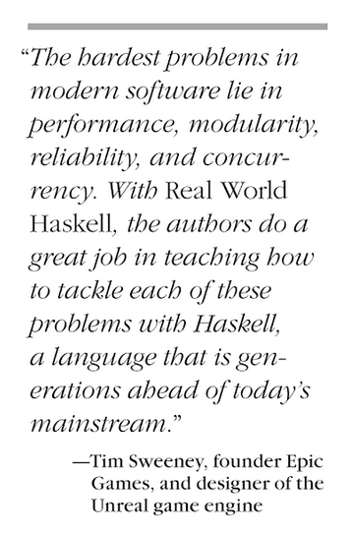
Diskussion
Fragen? Anregungen?

